Slide 1
Using MTT (Manufacturing Task Tracker) From Email notification June, 2011

Slide 2
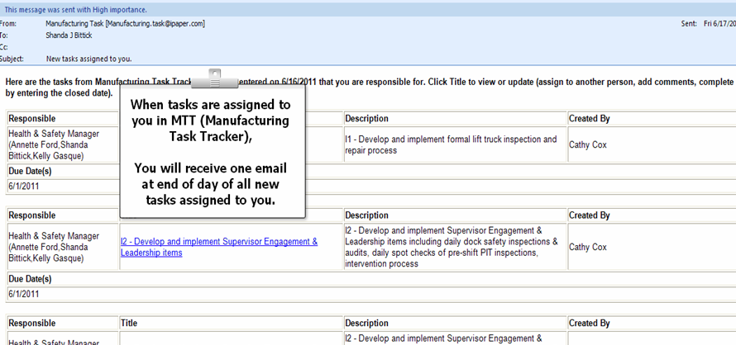
Email notification of Task Assignment

Slide 3
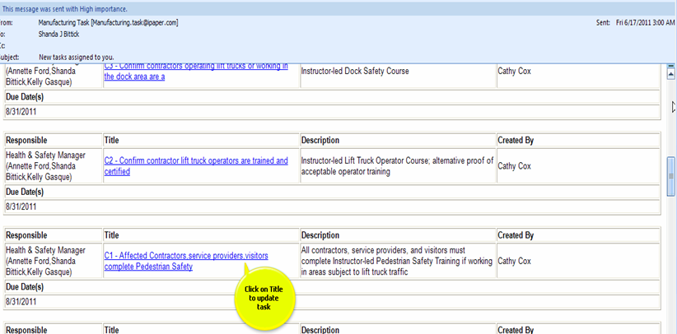
From email notification – Choose task to update

Slide 4
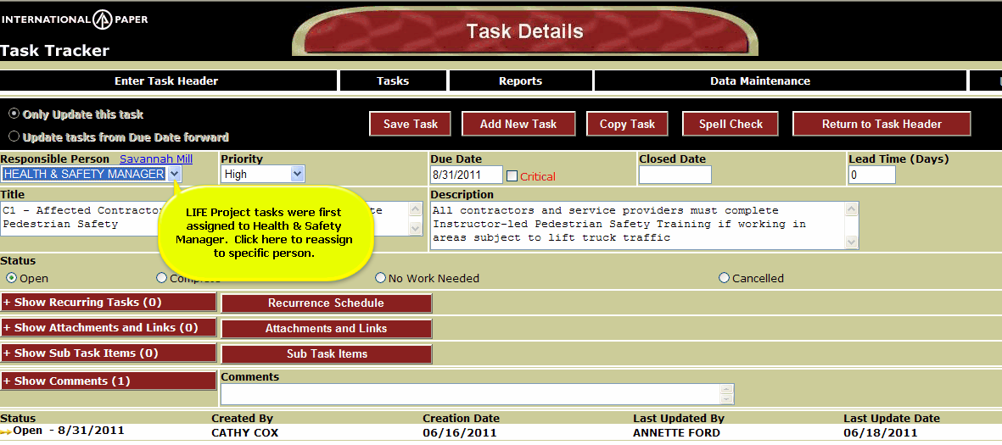
Can reassign task to “role” or specific individual

Slide 5
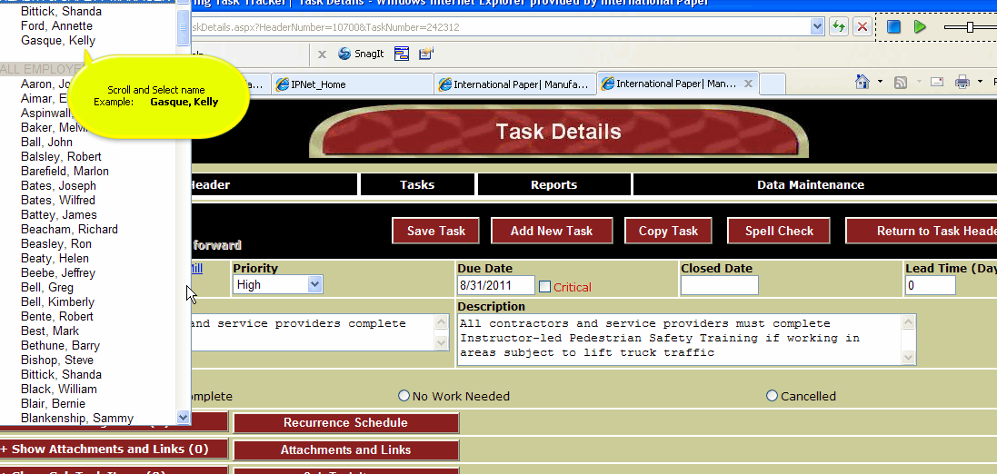
Choose name to reassign task

Slide 6
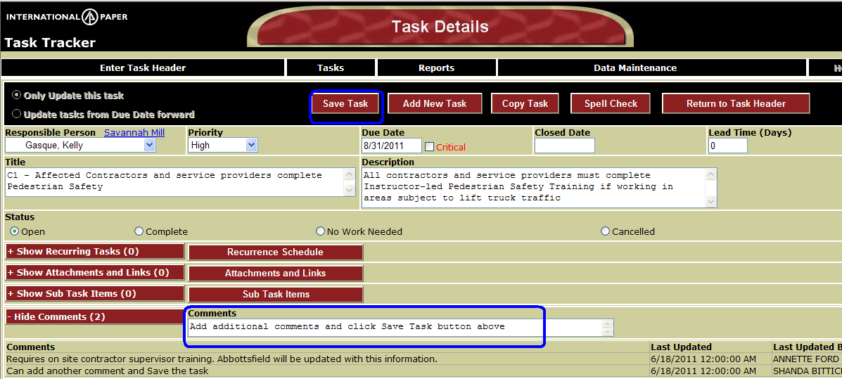
Adding comments to task
Type comment and click Save Task button.
To view comments click on Show Comments and comments will be displayed

Slide 7
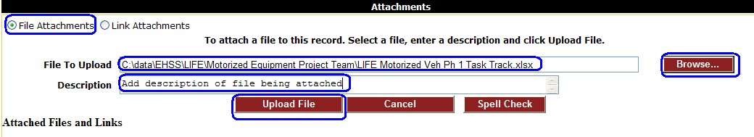
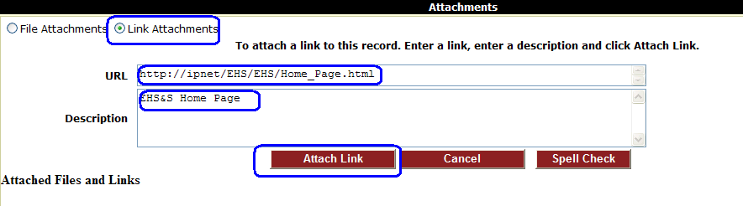
Adding Attachment/Link to task
File Attachment: Select the Browse button and choose file. Enter description and select Upload File.
Link: Choose Link Attachments. Enter the Web or Sharepoint address in the URL field (Can use Copy/Paste).
Enter description and select attach link.

Slide 8
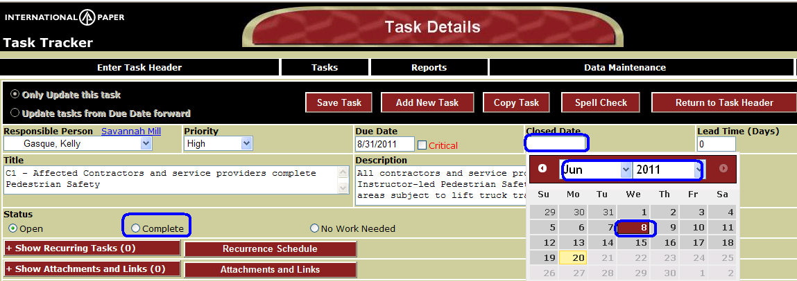
Marking a task complete
When you have completed a task: Click in Closed Date box
Select closed date (Month, Year and then day).
Status will automatically change to Complete

